Slide 1
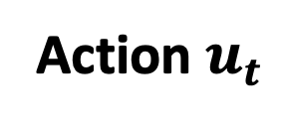
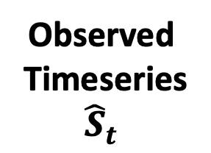

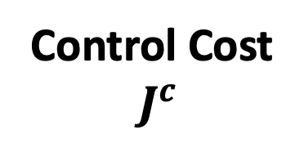
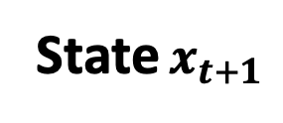
Observed
Timeseries
$${\hat{S}}_{t}$$
Control Cost
$J^{c}$
Controller
Adversarial
Perturbation
State $x_{t+1}$
Cannot Observe
Directly
Environment
$$S_{t}$$
Action $u_{t}$

